Slide 1

San Francisco earthquake
By: Salma MAHMOUD 8B

Slide 2
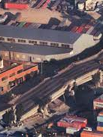
Geographical information
On October 17th, 1989, an earthquake struck San Francisco, accurately, San Francisco Bay Area, California, in United States. This earthquake’s magnitude is 6.9. It generated around $6 billion in valuables damage, about 3,800 abrasions, 63 deaths, and about 3,00 – 12,000 homeless people. It is considered as the second strongest earthquake to hit San Francisco, since San Francisco earthquake of 1906. The earthquake was brought on by a skid along the San Andreas Fault, and its epicenter was in the Forest of Nicene Marks State Park. The earthquake was located near Loma Prieto Peak in the Santa Cruz Mountains, and so, it is known as San Francisco-Oakland earthquake and Loma Prieto earthquake.
Reminder:
Epicenter is located above the focus (point at which the rock moves) on the earth’s surface.

Slide 3
Process
A powerful and destructive shaking hit the San Francisco Bay Area at 5:04 PM. The earthquake lasted for 10-15 seconds.
Unfortunately, the Oakland Athletics and San Francisco Giants was commencing at the same time of the earthquake. People quickly left the stadium, and some stayed hiding under their seats for the whole time.
Another area that was dangerously damaged was Watsonville, located several miles from the quake’s epicenter. 30% and more of Watsonville’s downtown was destroyed.

Slide 4
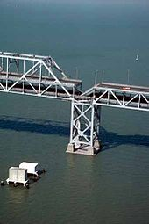
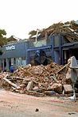
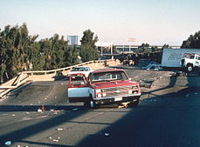
Effects and impacts
As the earthquake was also shared between San Francisco and Oakland, the number od damages and deaths was recorded from both cities. Oakland documented 42 deaths of 63. Most of these deaths were from the failure of the Cypress Street Viaduct on the Nimitz Freeway (Interstate 880), where a double-deck portion of the freeway collapsed on the cars that were om the lower deck. Also, Oakland Bay Bridge also collapsed, which lead to one case of death on the bridge.
Other reasons that explain the number of deaths are the collapse of the Pacific Garden Mall in Santa Cruz (3 people died), the collapse of a brick wall on Bluxome Street in San Francisco, the collapse of a five-story tower at St. Joseph’s Seminary in Santa Clara County, and the collapse of the top deck of the Nimitz Freeway onto the bottom deck.

Slide 5
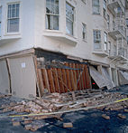
Effects and Impacts
Away from the fact that most damages were from landmarks that can now be less in the city, other impacts of the earthquake was affected by communities throughout the region.
San Francisco's Marina district was hit so hard, because it has been built on sandy soil, comprising loos land and unreinforced masonry buildings in Santa Cruz failed.
The transportation system of the Bay Area was completely damaged.
PS: the unreinforced masonry buildings in Santa Cruz were built from 50-100 years old.

Slide 6
To conclude
On the 18th of October 1989, the US Senate Committee on Commerce, Science and Transportation and the US House of Representatives Committee on Science, Space and Technology requested the National Institute of Standards and Technology (NIST) to investigate earthquake damage, including the elevated section of Interstate 880 and the other bridge structures. The team traveled to the San Francisco area and carried out its investigation and discovery from 18th of October till the 26th of October 1989.

